Slide 1


Newchurch Village Community Association

Slide 2
There are four areas we wish to register in Newchurch:-
1).The Bowling Green at The Boars Head
2). The Car Park at the Boars Head
3). The Little Park
4). The Car Park adjacent to the North side of St. Nicholas' Church.

Slide 3
3). The “Little Park”, Newchurch

Slide 4
The Black Dog public house was situated at 57a Church Street on the site which became known as "The Little Park" (village garden to the east of Bolton Street).
Built in 1767 it changed to a beerhouse in 1800. The Black Dog was a stagecoach inn with a four stalled coaching house. The building carried a date stone with 1767 carved in it. The pub carried the sign of a black dog on a dark blue background.
On the night of 19th January 1922 a storm caused the building to collapse and not long after had to be demolished.
In 1927 the "Little Park" came into being. The site was given to Rawtenstall Corporation by the owner Mr H. H. Bolton JP and was opened in March 1927.

Slide 5
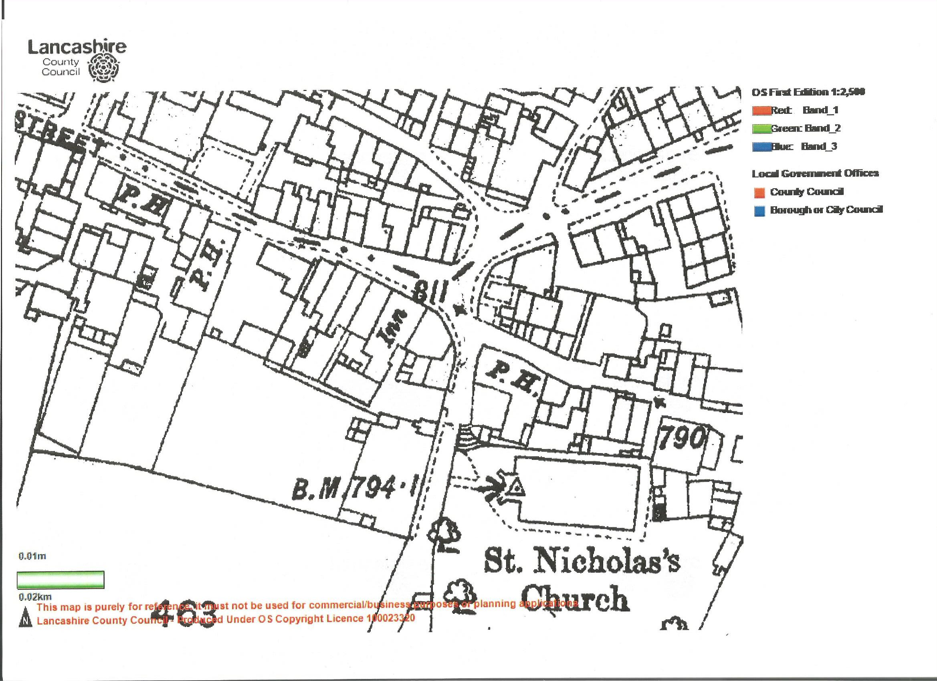
LCC Map of Site

Slide 6
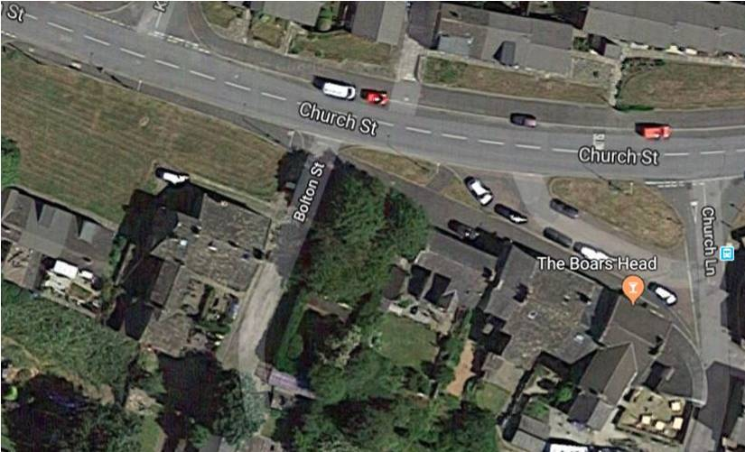
Aerial View of Site

Slide 7
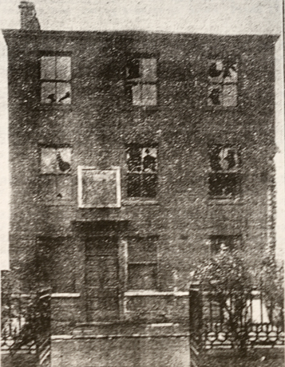
The Black Dog/ The “Little Park”, Newchurch

Slide 8
The Black Dog/The “Little Park”, Newchurch
During a storm on Saturday 19th January 1922 the Black Dog Inn suddenly collapsed. The three storey building had been in a dilapidated state for many years. On Sunday the rear walls collapsed with part of the masonry falling in the garden of Plane Tree House, the home of Mr. Baker, the headmaster of Thistlemount Continuation School.
Only the front part of the old hostelry on Church Street remained standing, though this was of no great loss as the building was already earmarked for demolition.

Slide 9
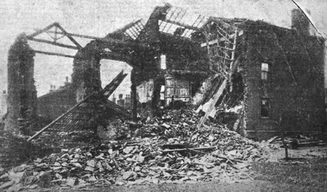
The Black Dog/The “Little Park”, Newchurch

Slide 10
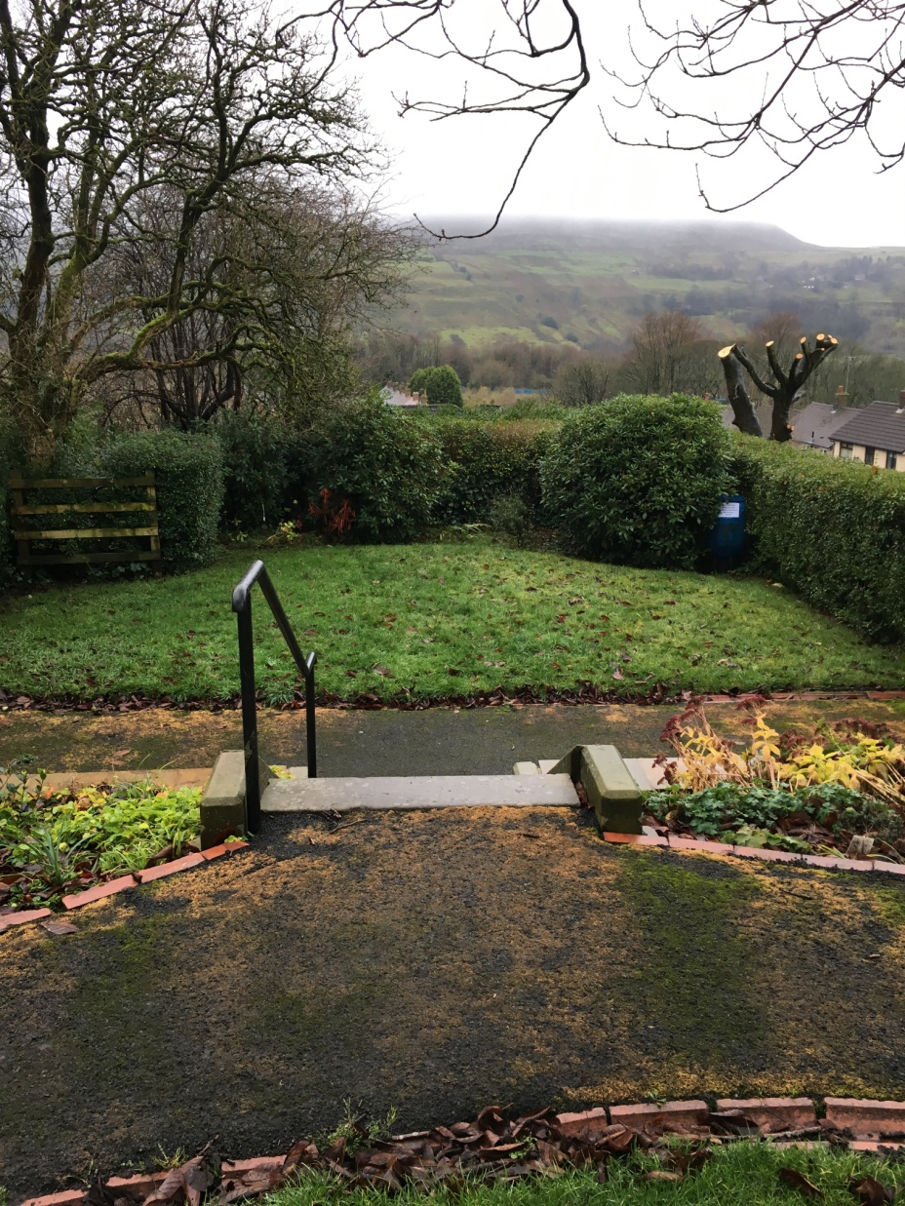
The “Little Park”, Newchurch

Slide 11
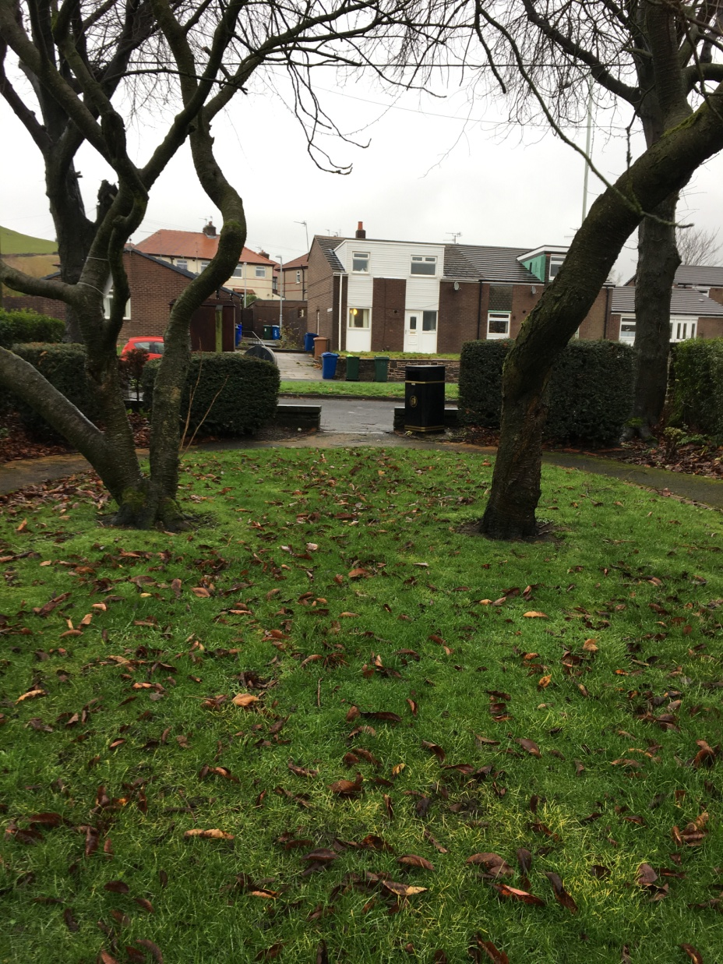
The “Little Park”, Newchurch

Slide 12
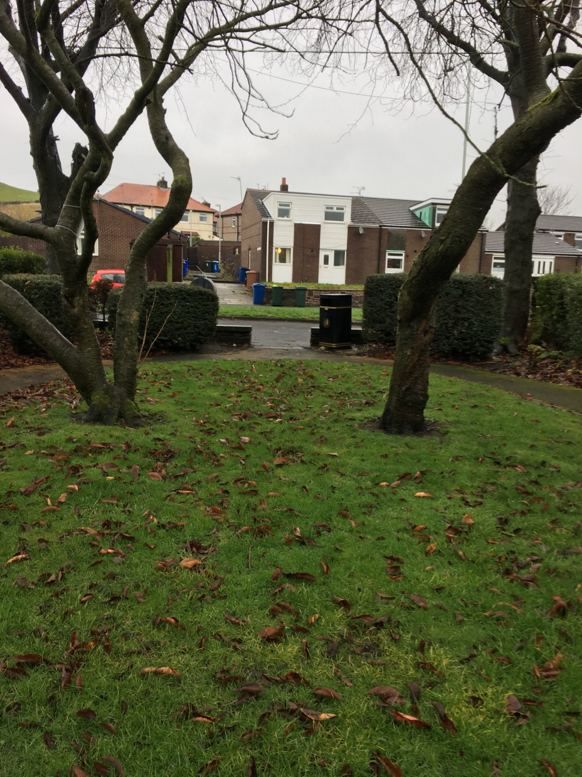
The “Little Park”, Newchurch

Slide 13
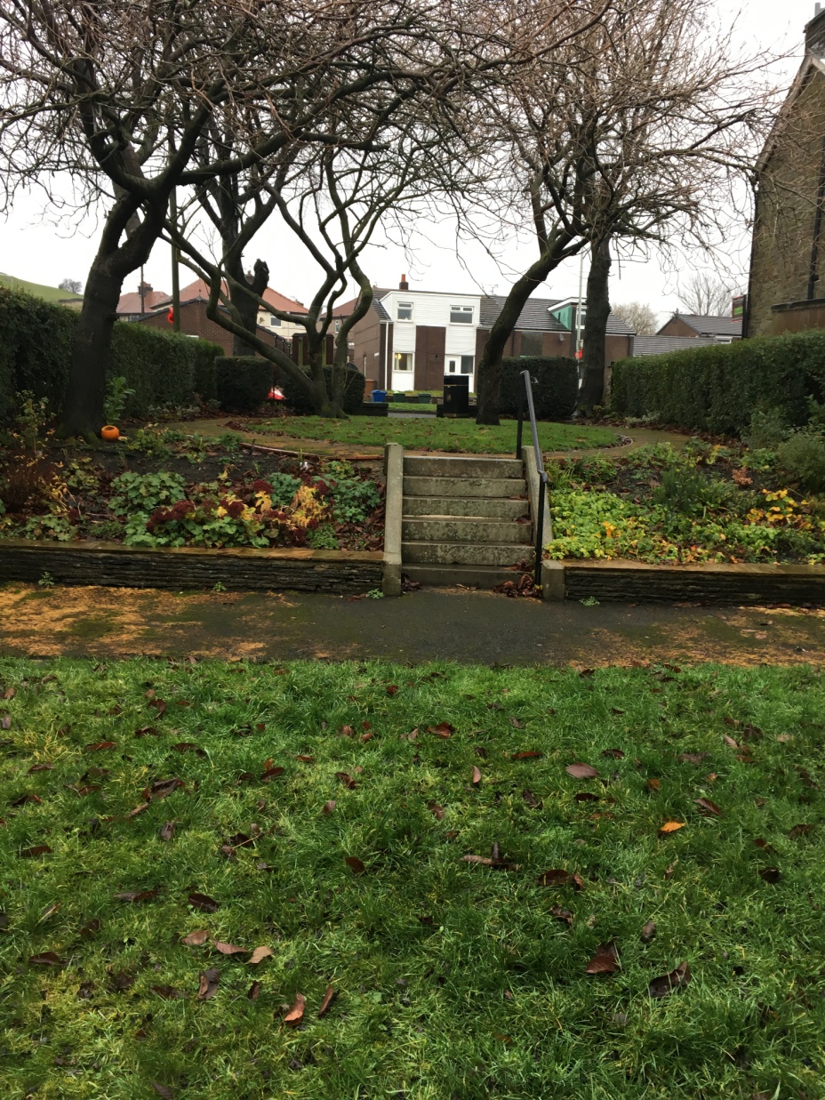
The “Little Park”, Newchurch

Slide 14
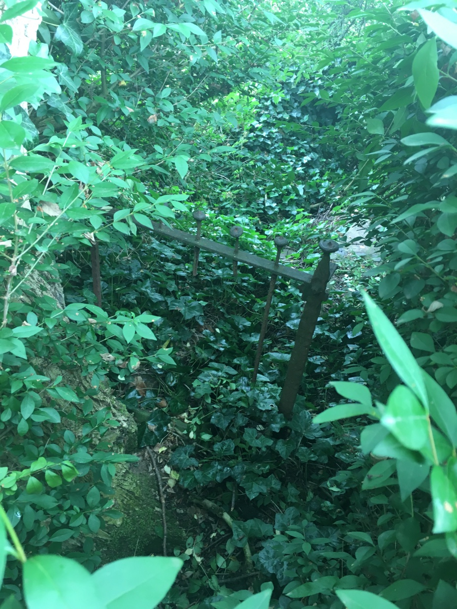
The “Little Park”, Newchurch

Slide 15
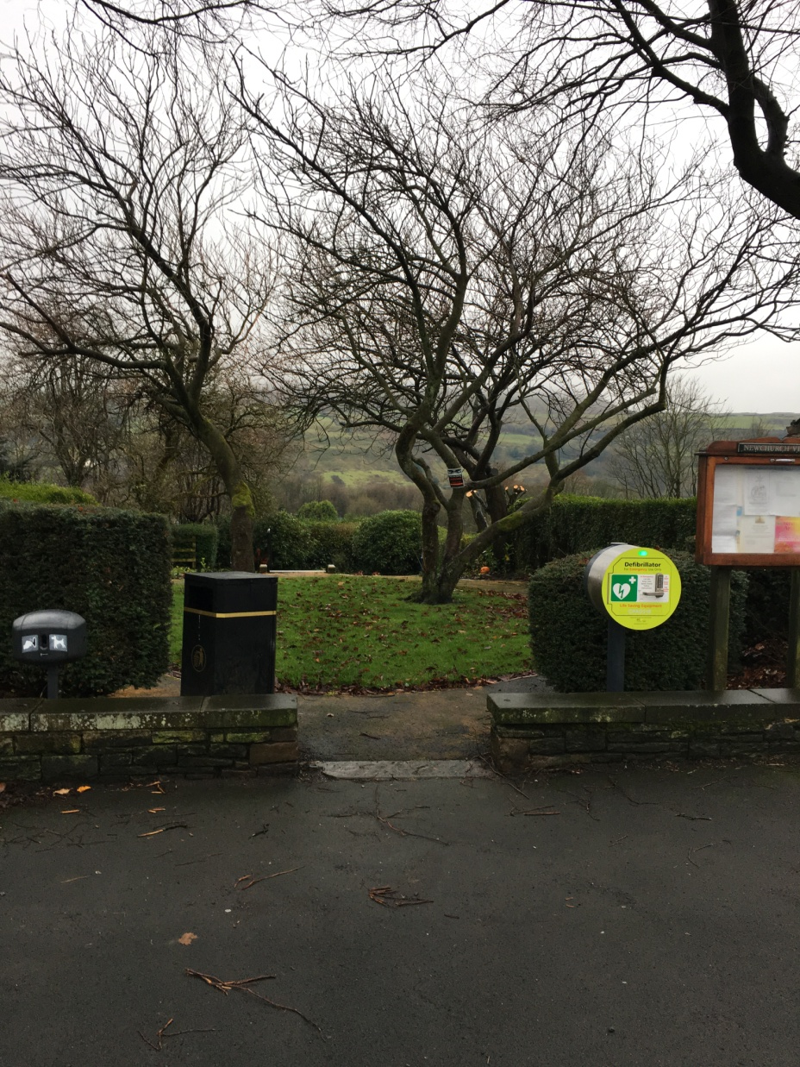
The “Little Park”, Newchurch

Slide 16
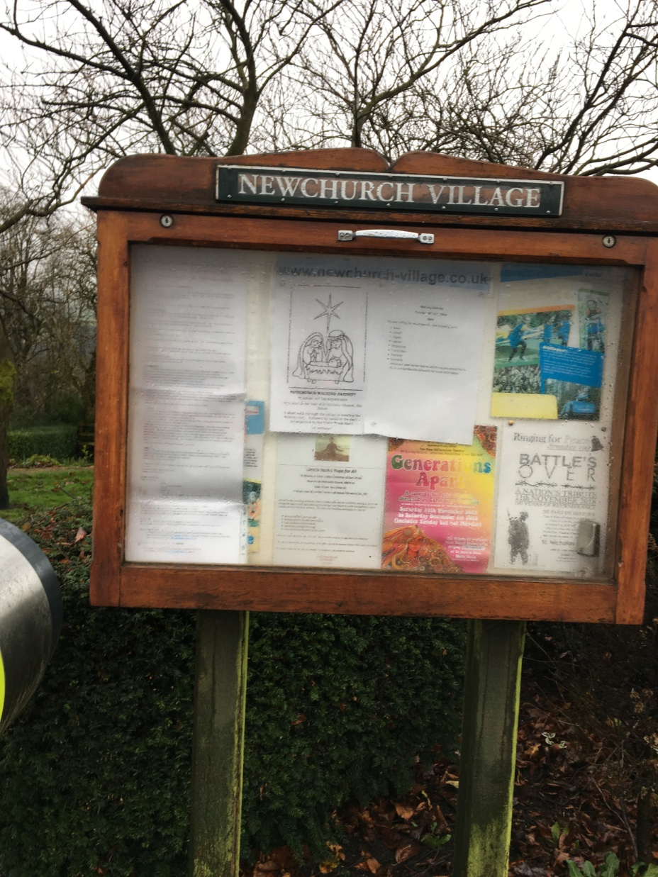
The “Little Park”, Newchurch

Slide 17
The “Little Park” & NVCA
Newchurch Village Community Association has taken over the general gardening of the “Little Park”.
NVCA has commissioned a notice board for the use of the community.
NVCA have installed and maintain a defibrillator for the community.
NVCA have installed Christmas Lights in the trees together with Rossendale MBC

Slide 18
The “Little Park”, Newchurch

Slide 19
Newchurch Village Community Association

